Slide 1
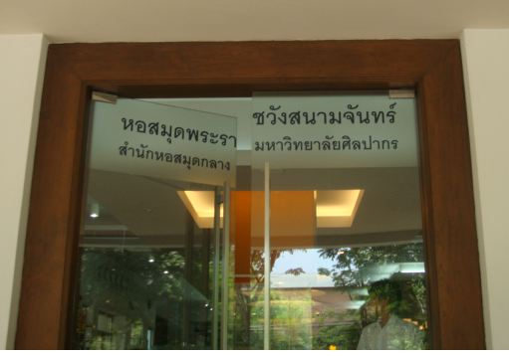
WE
Notes:
We are facing bout the NEW.. New trends, technology, new comer … in the old library.

Slide 2
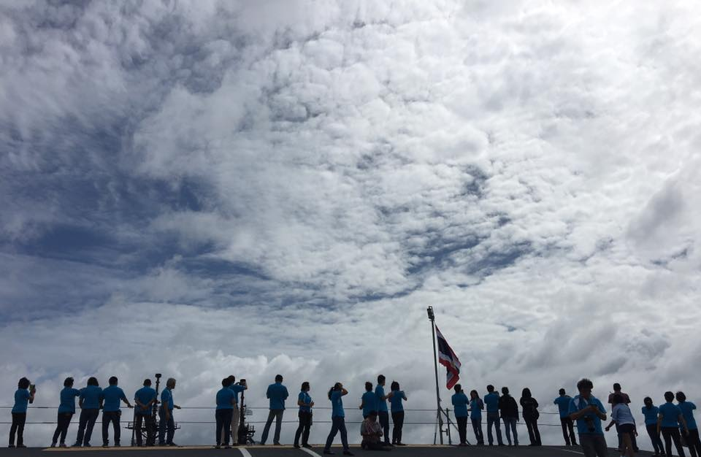
We have 47 people.
Notes:
We are facing bout the NEW.. New trends, technology, new comer … in the old library.

Slide 3
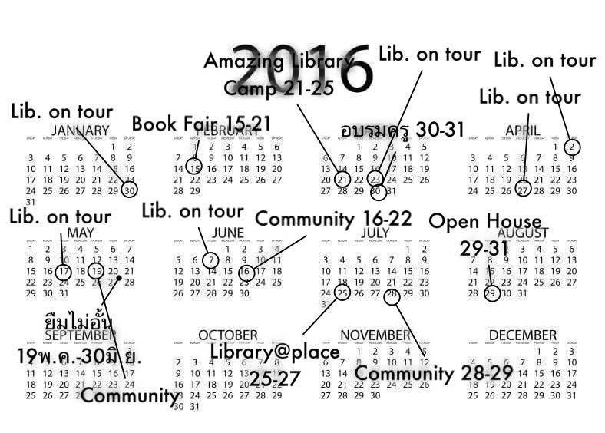
We do in 365 days.
Notes:
We are facing bout the NEW.. New trends, technology, new comer … in the old library.

Slide 4
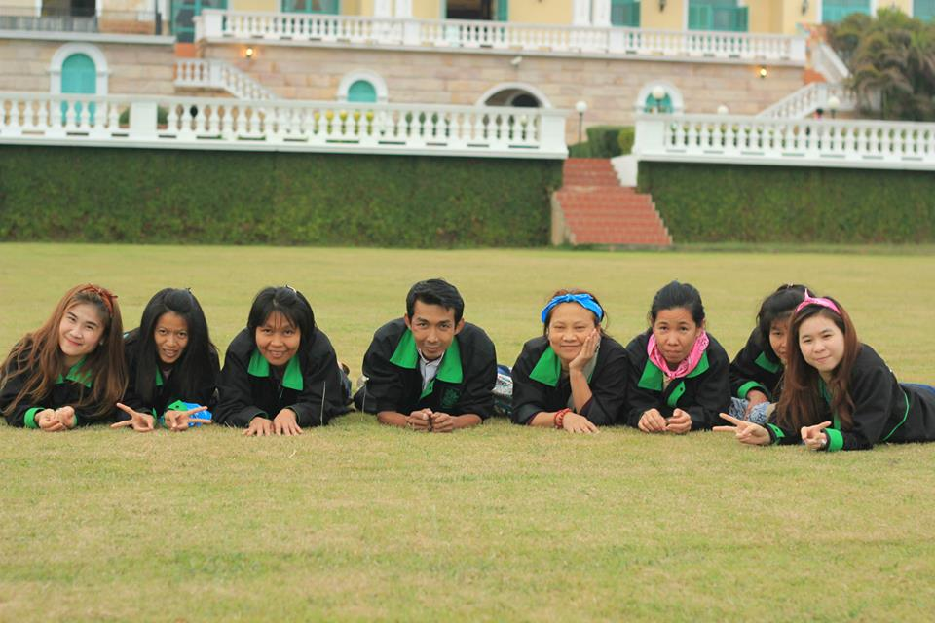
We have proactive services.
Notes:
We are facing bout the NEW.. New trends, technology, new comer … in the old library.

Slide 5
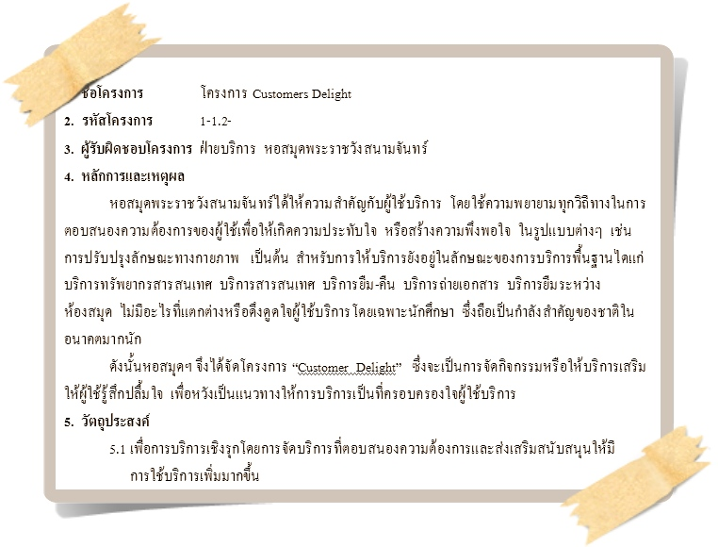
1. Customer Delight
Notes:
We are facing bout the NEW.. New trends, technology, new comer … in the old library.

Slide 6
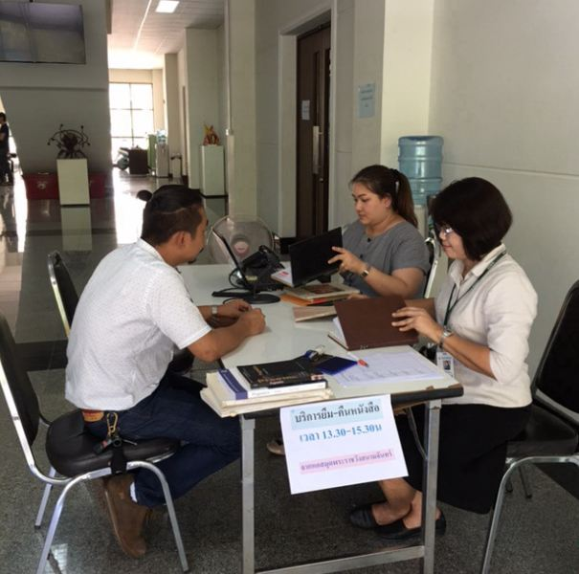
1.1 Library@Place
Notes:
We are facing bout the NEW.. New trends, technology, new comer … in the old library.

Slide 7
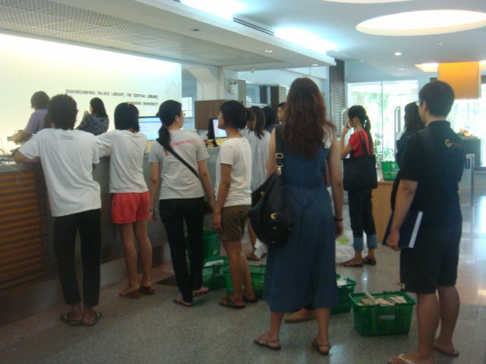
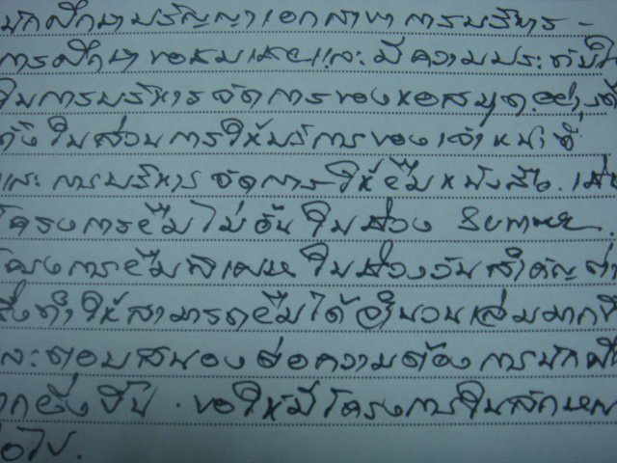
1.2 Unlimited
Notes:
We are facing bout the NEW.. New trends, technology, new comer … in the old library.

Slide 8
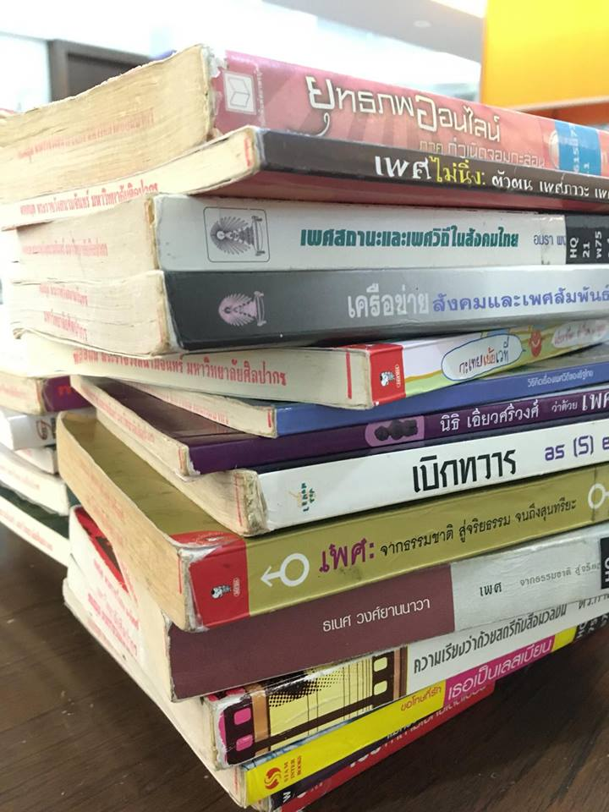
1.3 Library Bonus
Notes:
We are facing bout the NEW.. New trends, technology, new comer … in the old library.

Slide 9
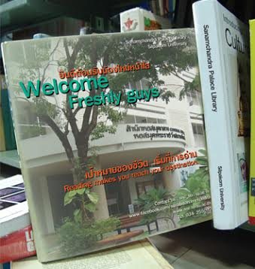
1.4 Library Orientation
Notes:
Good morning ladies and gentleman.

Slide 10

2. ชื่นใจ Library
Notes:
We are facing bout the NEW.. New trends, technology, new comer … in the old library.

Slide 11
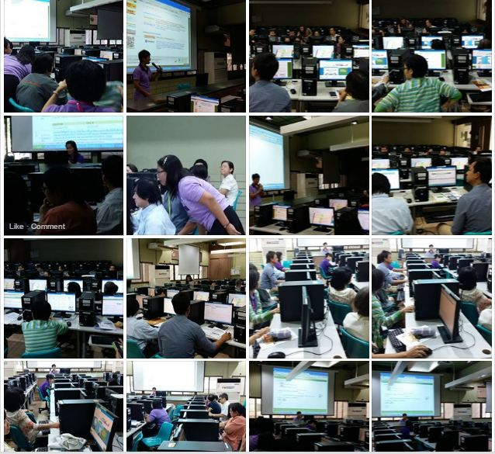
3. Library on tour
Notes:
We are facing bout the NEW.. New trends, technology, new comer … in the old library.

Slide 12
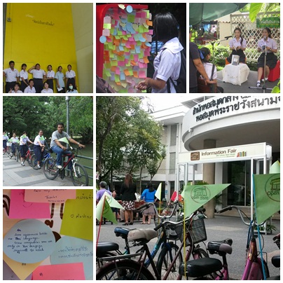
4. Open House
Notes:
We are facing bout the NEW.. New trends, technology, new comer … in the old library.

Slide 13
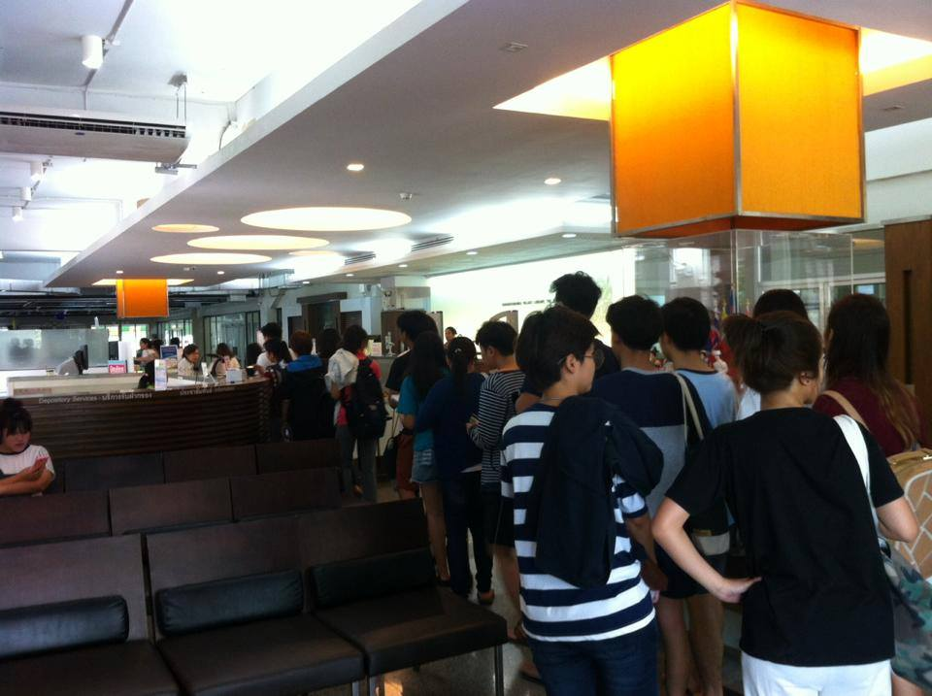
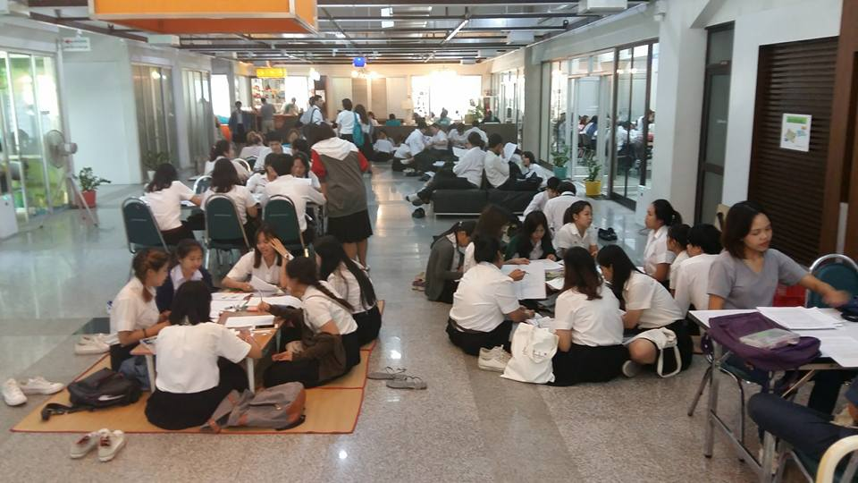
5. Extra…
Notes:
We are facing bout the NEW.. New trends, technology, new comer … in the old library.

Slide 14
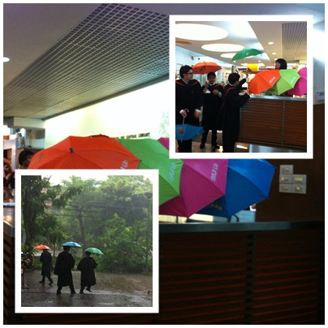
5. Extra…
Notes:
We are facing bout the NEW.. New trends, technology, new comer … in the old library.

Slide 15
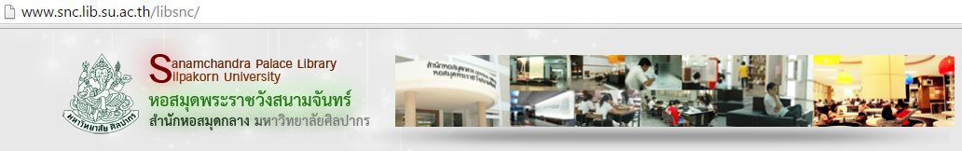
We have online services.
Notes:
We are facing bout the NEW.. New trends, technology, new comer … in the old library.

Slide 16
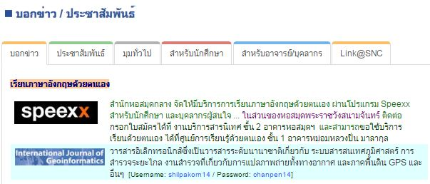
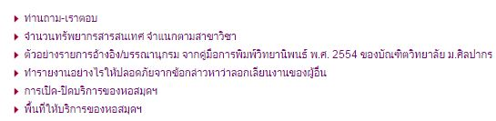
1. Link@SNC
Notes:
We are facing bout the NEW.. New trends, technology, new comer … in the old library.

Slide 17

2. Thai Western Regional
Information Center

Slide 18

3. Online Exhibition

Slide 19
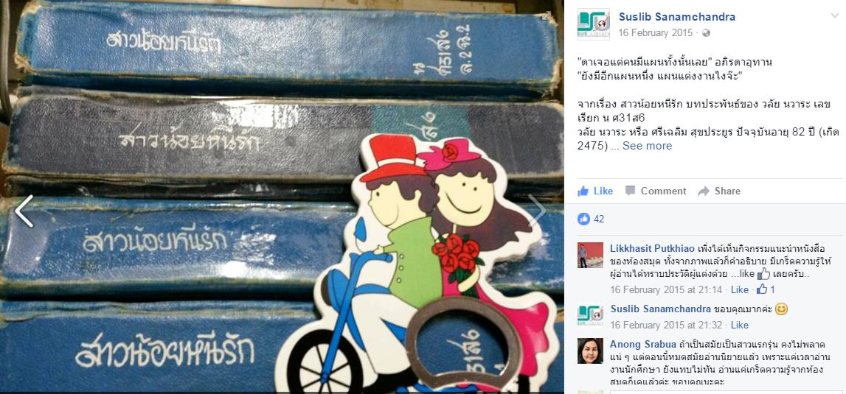
4. Social network: Facebook

Slide 20
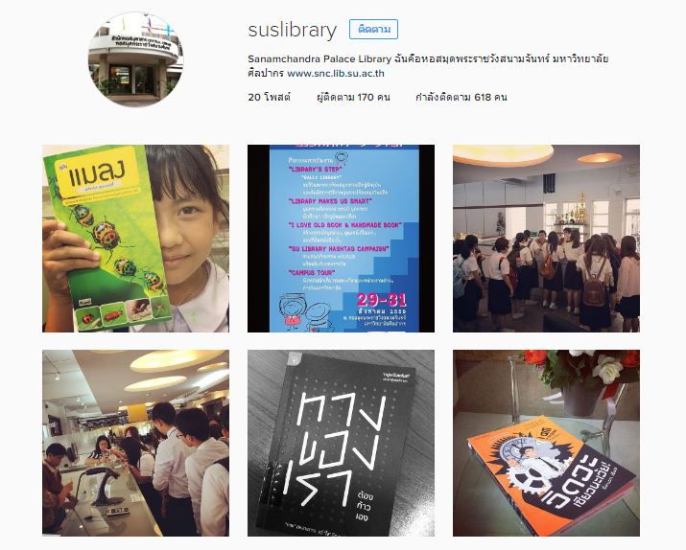
4. Social network: instagram

Slide 21
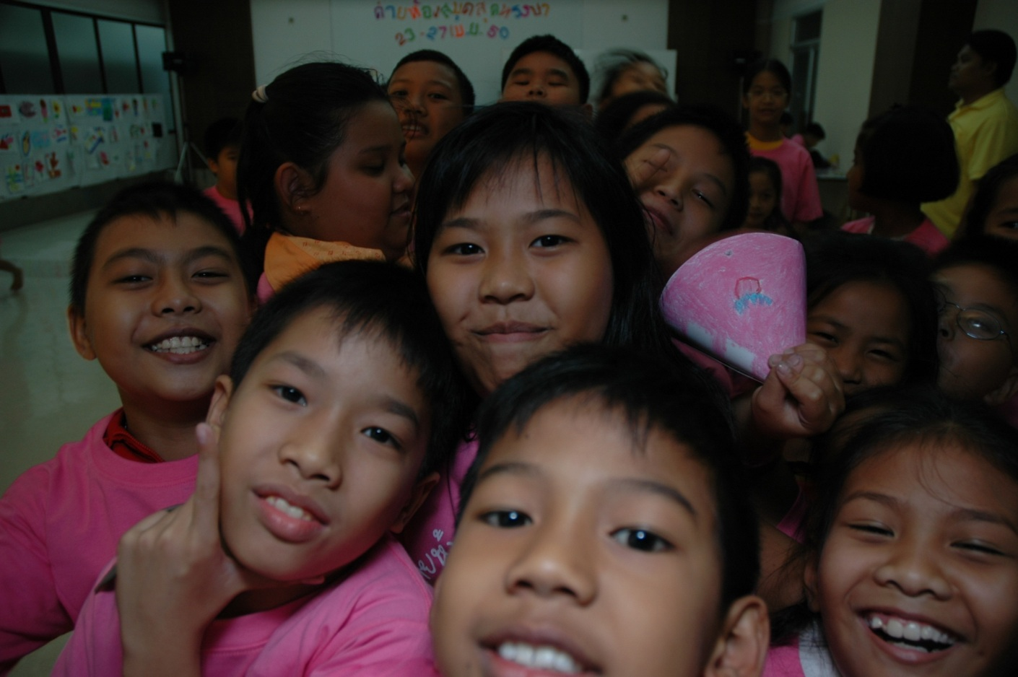
We have
community services.
Notes:
We are facing bout the NEW.. New trends, technology, new comer … in the old library.

Slide 22
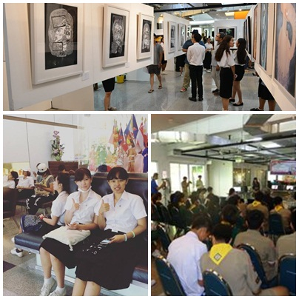
1. Space
Notes:
Good morning ladies and gentleman.

Slide 23

2. Tubkaew Bookfair
Notes:
Good morning ladies and gentleman.

Slide 24
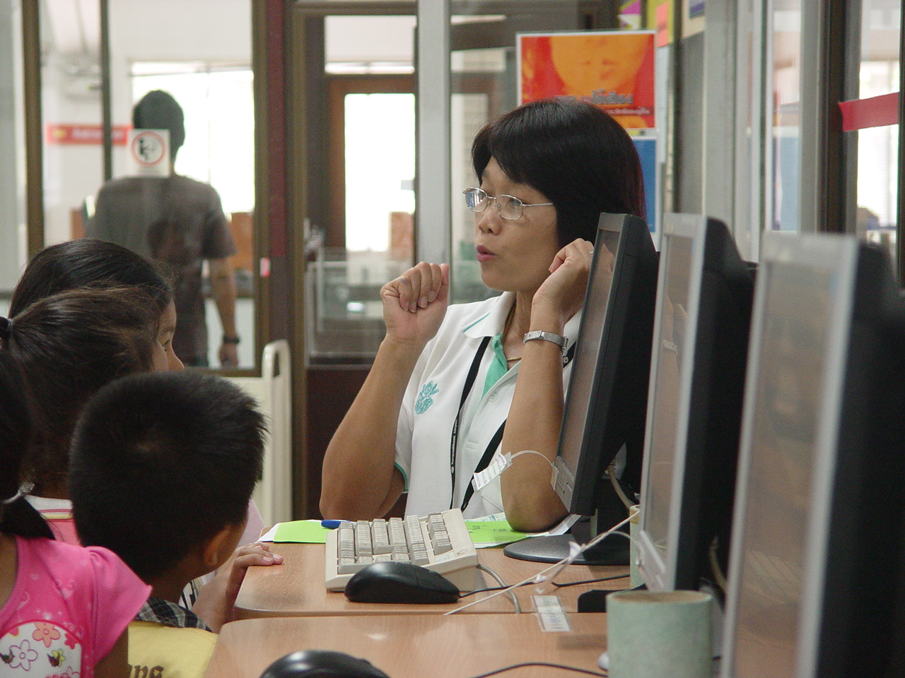
3. Amazing Library Camp
Notes:
Good morning ladies and gentleman.

Slide 25
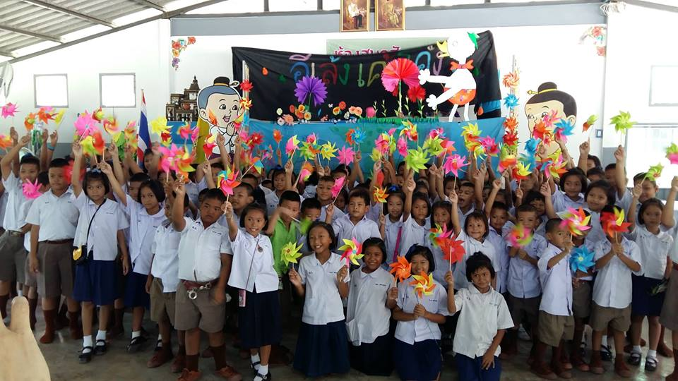
4. Happy Library Tour
Notes:
Good morning ladies and gentleman.

Slide 26
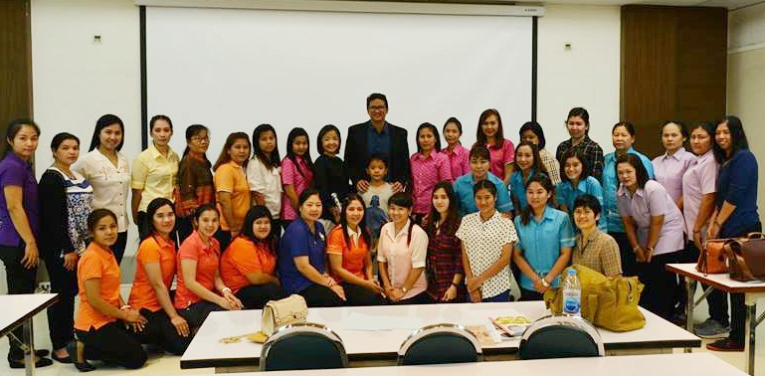
5. Training
Notes:
Good morning ladies and gentleman.

Slide 27
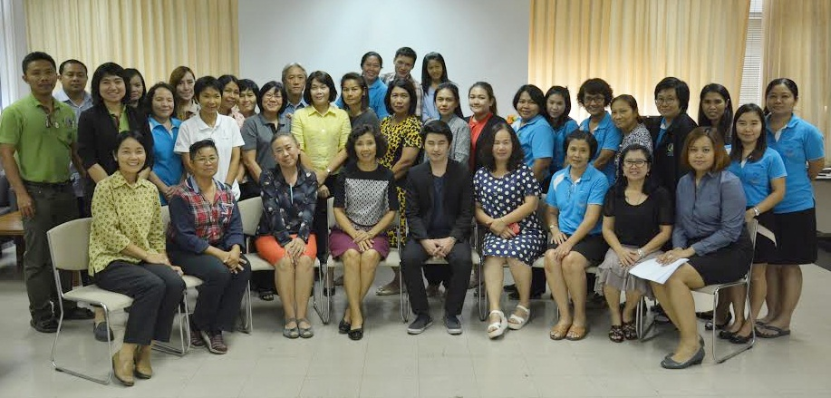
6. Seminar
Notes:
Good morning ladies and gentleman.

Slide 28
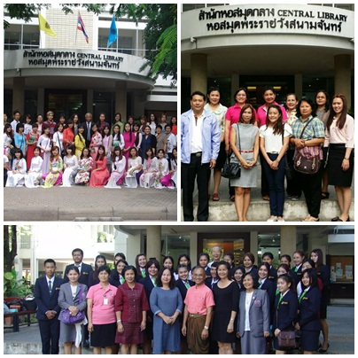
7. Visitors
Notes:
Good morning ladies and gentleman.

Slide 29
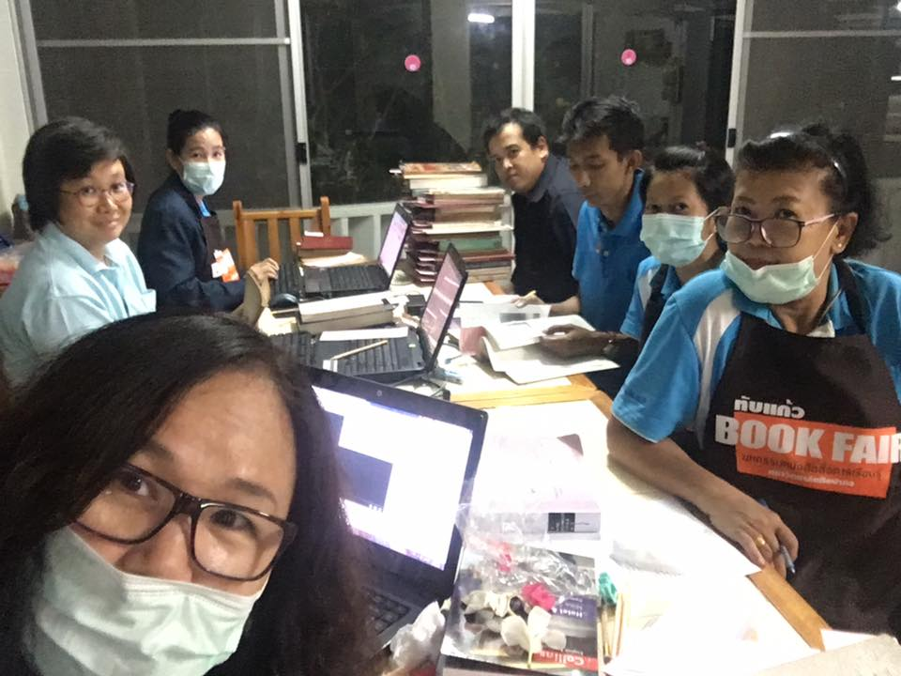
8. One library in a year
Notes:
Good morning ladies and gentleman.

Slide 30
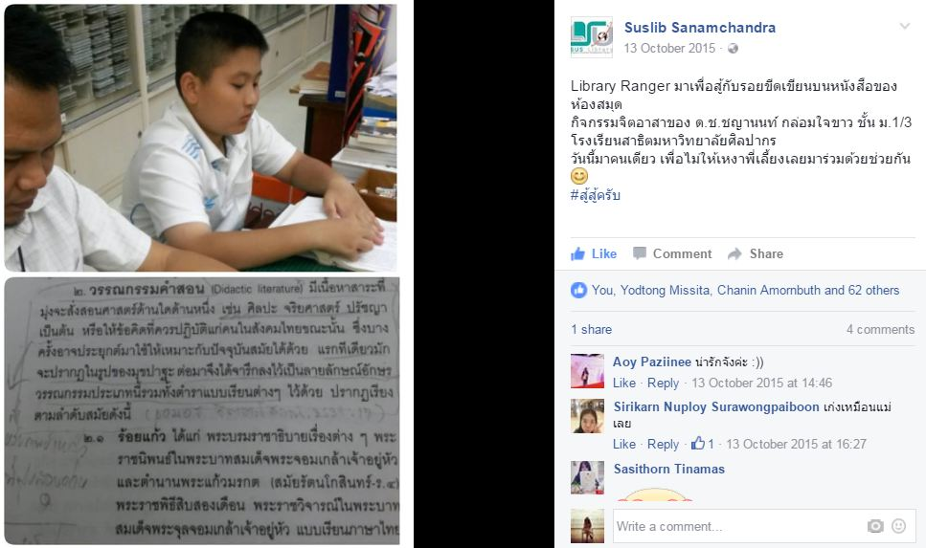
9. Volunteer
Notes:
Good morning ladies and gentleman.

Slide 31
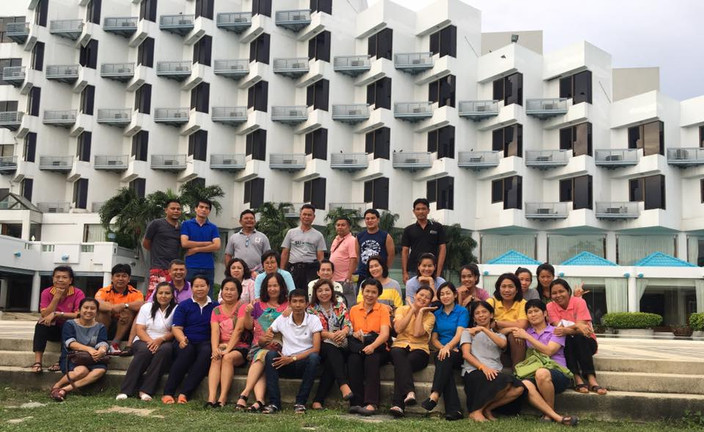
We have lovely staffs.
Notes:
We are facing bout the NEW.. New trends, technology, new comer … in the old library.

Slide 32
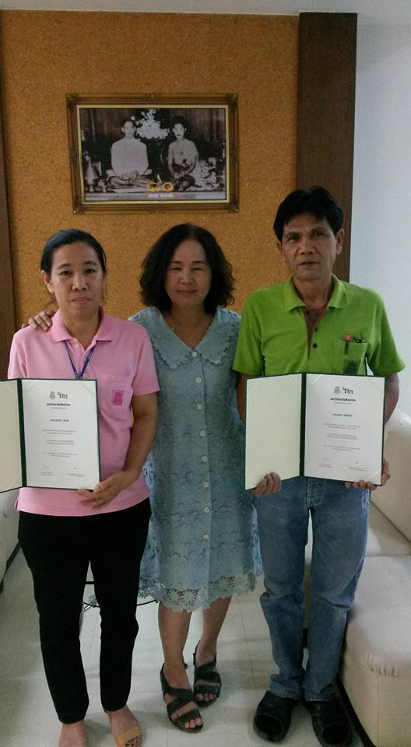
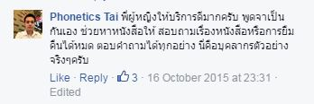
We’re proud of you.
Notes:
We are facing bout the NEW.. New trends, technology, new comer … in the old library.

Slide 33
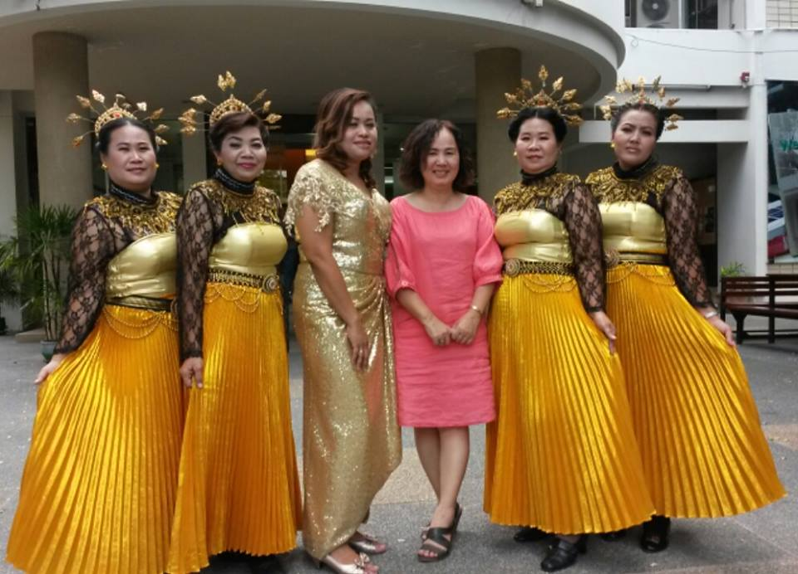
We care
Notes:
Good morning ladies and gentleman.

Slide 34
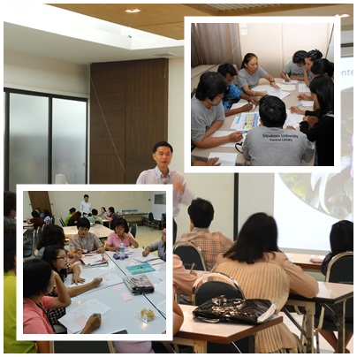
We learn
Notes:
Good morning ladies and gentleman.

Slide 35
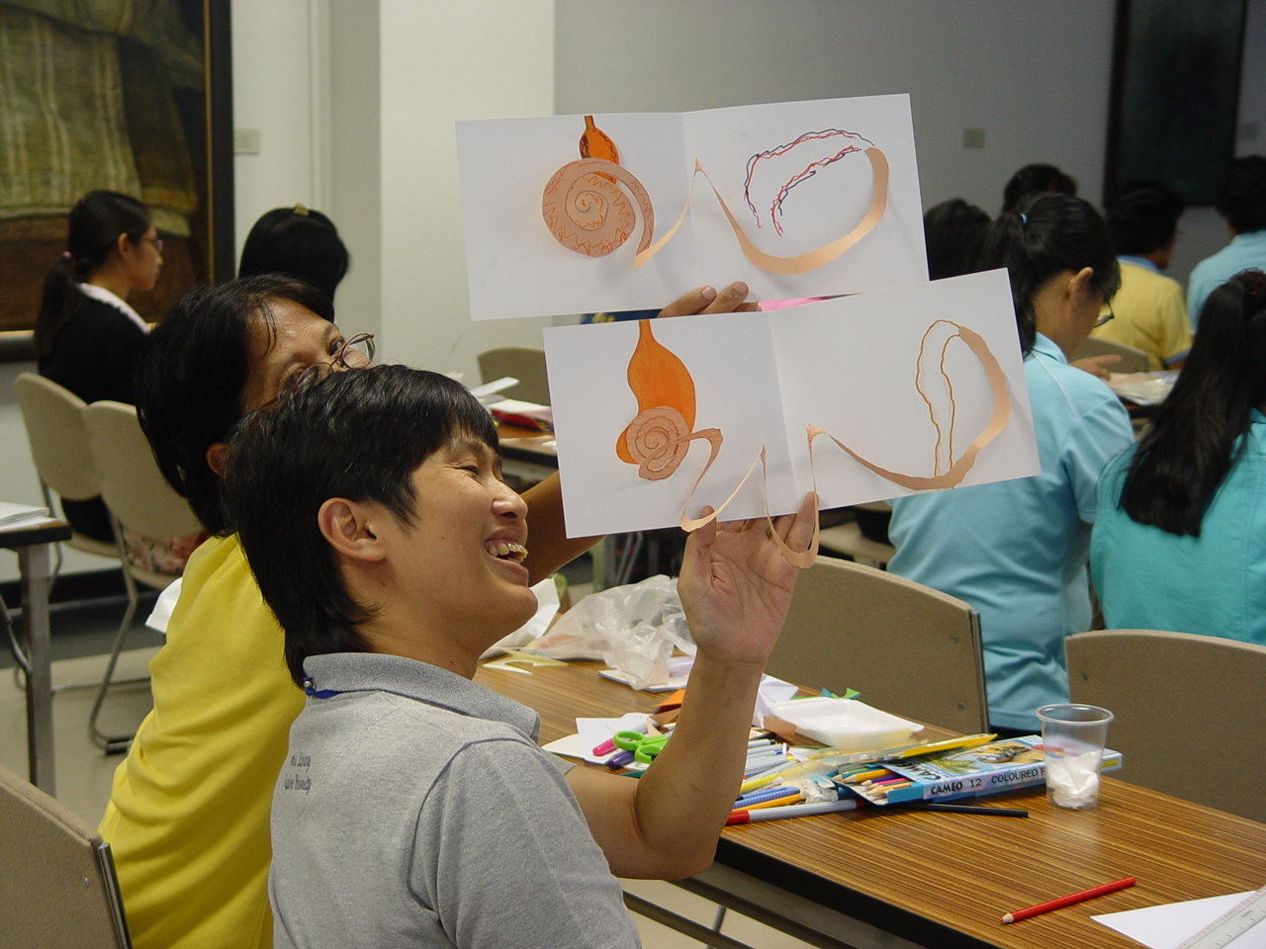
We try
Notes:
Good morning ladies and gentleman.

Slide 36
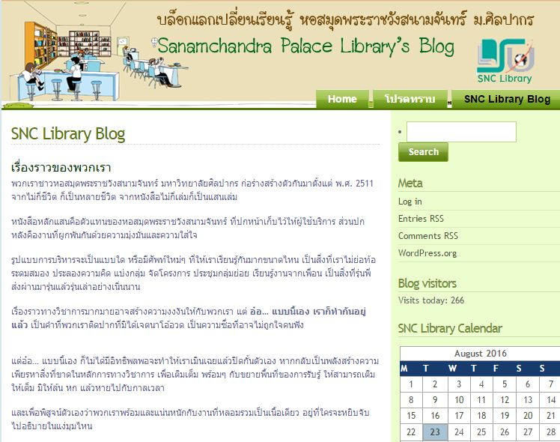
We share
Notes:
Good morning ladies and gentleman.

Slide 37

Library’s Step
Notes:
We are facing bout the NEW.. New trends, technology, new comer … in the old library.

Slide 38
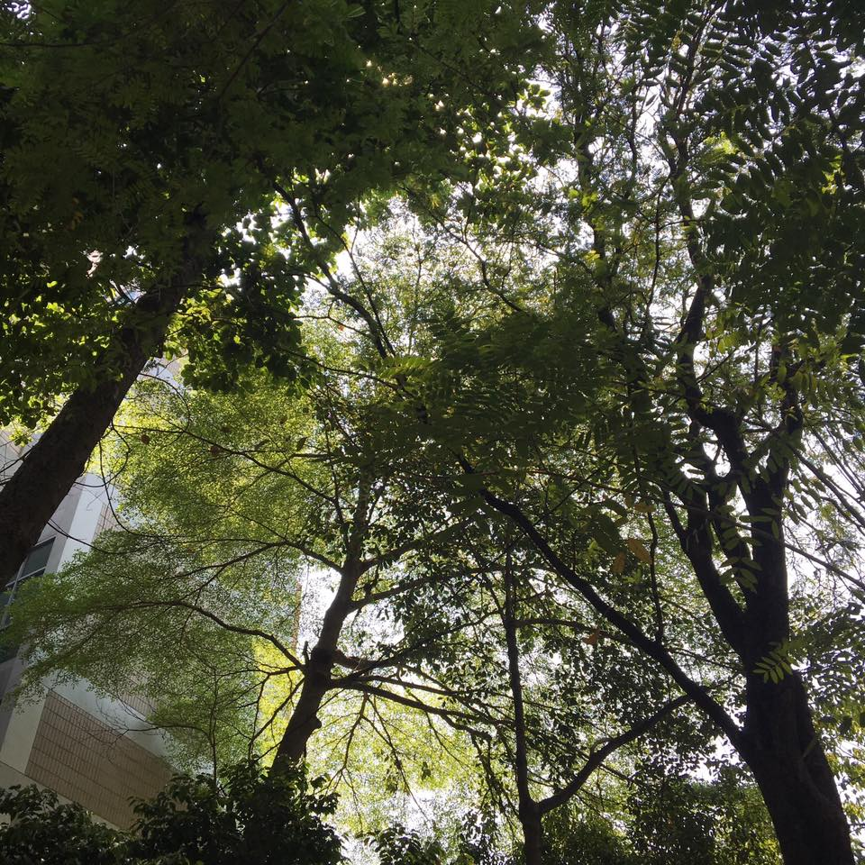
Great books wait for you at the library.
Great library makes great university.
Thank you, thank you, thank God for you, the wind beneath my wings.
Notes:
We are facing bout the NEW.. New trends, technology, new comer … in the old library.

